Slide 1

xiaoR Geek Raspberry Pi series of primary tutorial
--
Shenzhen XiaoR Geek Technology Co., Ltd
www.wifi-robots.com Development tools ;WinSCP, putty, ssh (code upload run)

Slide 2
catalogue
1. the development environment and tools introduced
2. python code written
3. the code and upload (WinSCP) and run (putty, SSH2)

Slide 3
1.Development environment and tools
XiaoR Geek Raspberry Pi, the internal has been integrated python library, can be run directly python program.
Has been integrated SSH2, can be directly connected through SSH2 and control raspberry pi.
Username: pi Password: raspberry
The system has integrated Wi-Fi AP function,insert the camera afer power-up, automatically open the WiFi hotspot
The network port is set to a static IP address and is easy to access.
Wi-Fi SSID: wifi-robots.com Password: 12345678
Wired network port IP: 192.168.88.100 (computer settings IP 192.168.88.2 can be accessed directly)

Slide 4
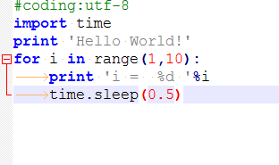
3.python code written
#coding:utf-8
import time
print 'Hello World!'
for i in range(1,10):
print 'i = %d '%i
time.sleep(0.5)
Create a text file named helloworld.py, using the notepad++ editor, enter the right content, pay attention to the use of English input method. The effect is at the bottom right of the screenshot.Which use the TAB key as the format specifier..
Code notes are as follows：

Slide 5
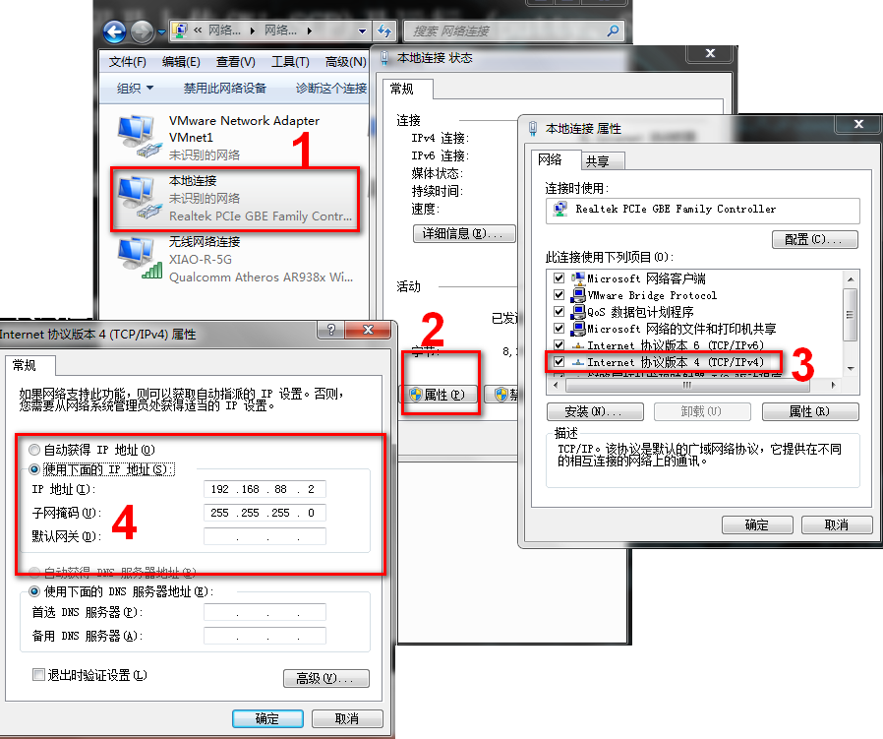

3. the code and upload (WinSCP) and run (putty, SSH2)
1、Computer connection raspberry pi（ insert the camera afer power-up. Automatically open hot spots）
Wireless connections：WiFi SSID：wifi-robots.com
Wired connection: IP address is 192.168.88.2
Steps reference right graph

Slide 6
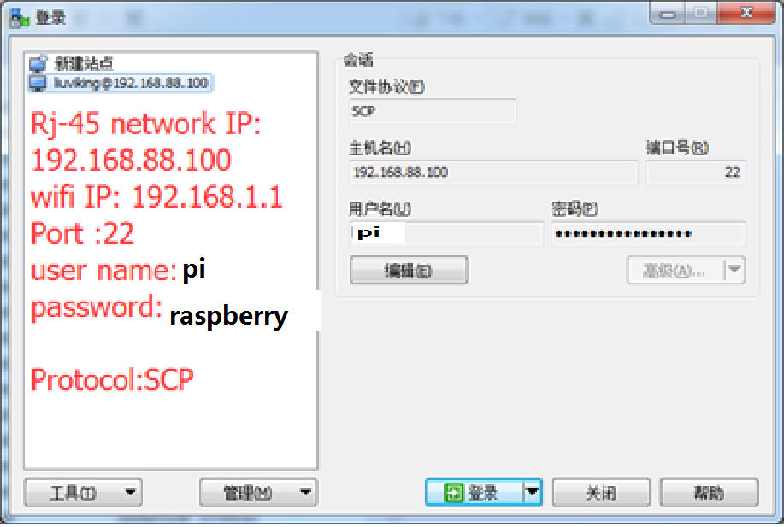

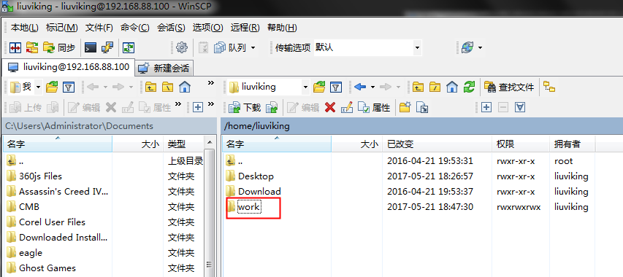
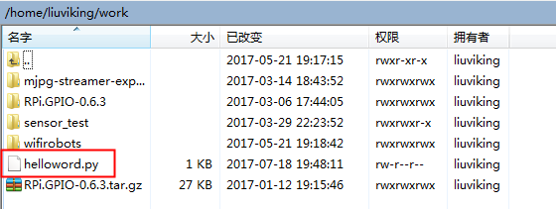
2, WinSCP upload program
A, open the installed WinSCP program
B, login WinSCP,
File Protocol: Select SCP
Hostname: wifi connection to 192.168.1.1,
The network connection is 192.168.88.100
Port number: 22
Username: pi
Password : raspberry
C, you can save the connection, the next direct use.
D, click to login.
E, the editor of the program into the work folder (you can double-click into the work folder, then dragged into the file)

Slide 7
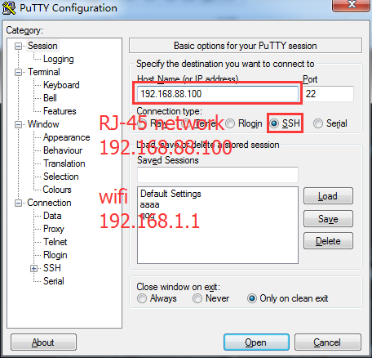

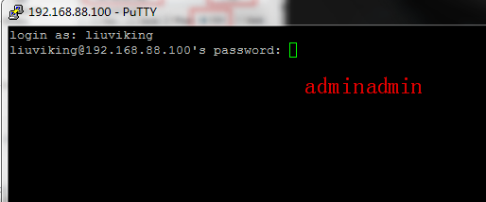
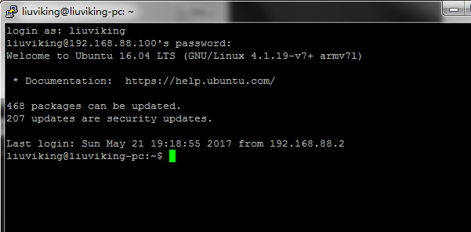
3, run the program
A, double-click the run putty program
B, login putty,
Hostname: wifi connection to 192.168.1.1,
The network connection is 192.168.88.100
Port number: 22
C, click OPEN
Username: pi
Password: raspberry (password is hidden, enter and click Enter)
D, the following print information appears, it is already successfully connected through the ssh, you can start playing.

Slide 8
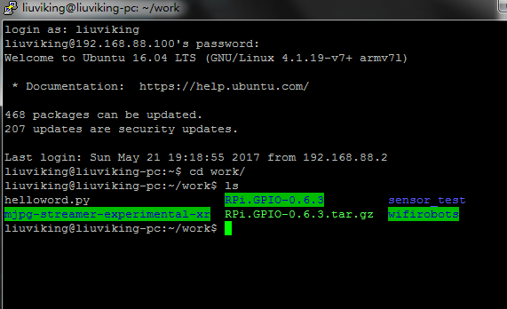
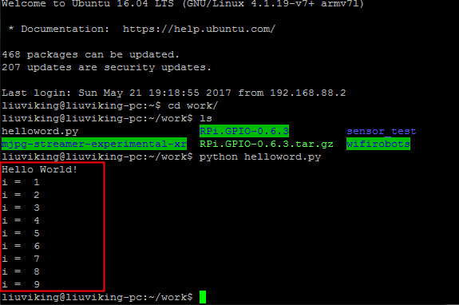
E, import cd work / and enter, enter the source code and then store the folder.
ps: input work, you can press the TAB key after input w, will automatically fill the path.
F, enter ls and press Enter to display the files in the current folder. You can see the files named helloworld.py that have just been uploaded
G, enter python helloworld.py, and press Enter to see the code running.
ps: When you enter helloworld.py, you can press the TAB key after input h to complete it automatically.
Code effect:
Print Hello World!
From i = 1, every 0.5s print to i = 9 after the end of the program

